Slide 1
Entertainer Data Analysis
Presented by
Piyush Upadhyay

Slide 2
Introduction
The entertainment industry relies heavily on data for insights into trends and audience preferences. This report analyzes entertainer data, focusing on Singer and Actor Profession. Using advanced techniques, we aim to extract actionable insights for entertainers and their teams. The dataset offers a comprehensive view. Key objectives include the top Oscar winners list, and the top 10 Entertainers with the most awards, aiming to optimize strategies and engagements in the industry.

Slide 3
Problem Statement
Normal life can be stressful, and people need to relax. Being entertained by others is a wonderful way to take some time out of life. It can reduce stress and make life's issues easier to face. The media and entertainment industry consists of film, television, radio and print. These segments include movies, TV shows, radio shows, news, music, newspapers, magazines, and books. The entertainment industry is a group of sub-industries devoted to entertainment. The entertainment industry is used to describe the mass media companies that control the distribution and manufacture of mass media entertainment

Slide 4
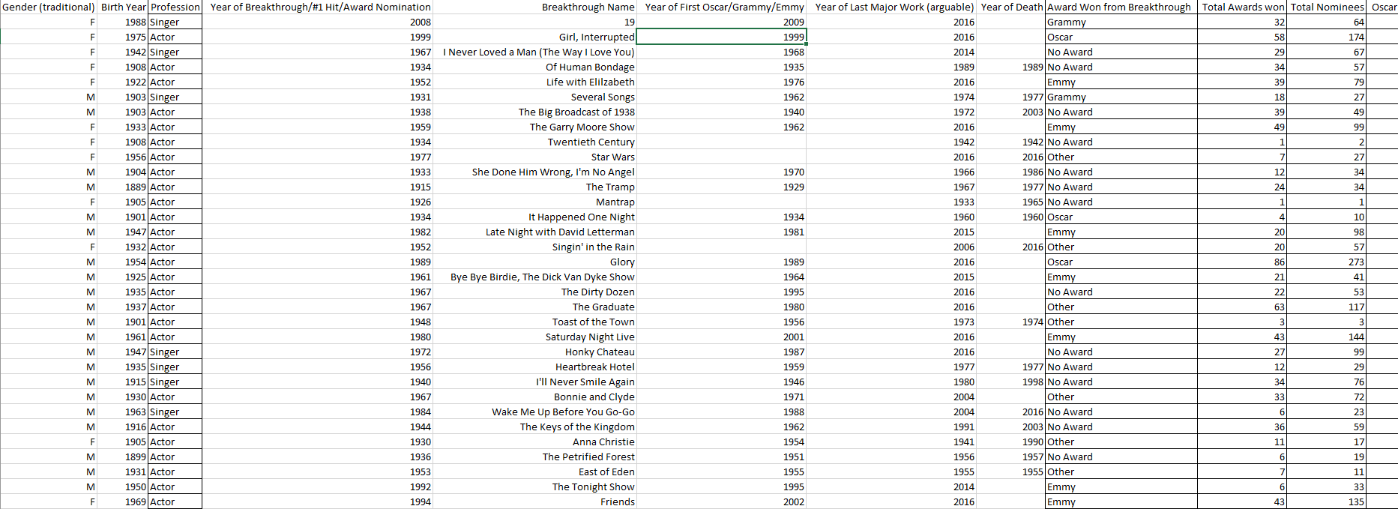
Dataset
KIANA ANDERSON, OPERATIONS MANAGER
DATE

Slide 5
Main KPI’s
Visualization of Singers & Actors with their respective awards.
Awards Distribution
Entertainer with their Profession
Top Entertainer with Big Number of Awards
Visualization of Total Nominees & Total Awards Won
Top Entertainer with their different type of Winning Awards
KIANA ANDERSON, OPERATIONS MANAGER
DATE

Slide 6
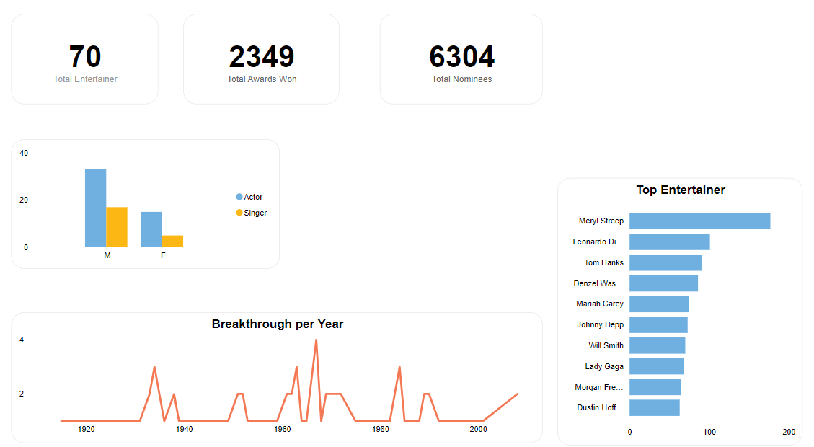
Mock Dashboard
KIANA ANDERSON, OPERATIONS MANAGER
DATE

Slide 7
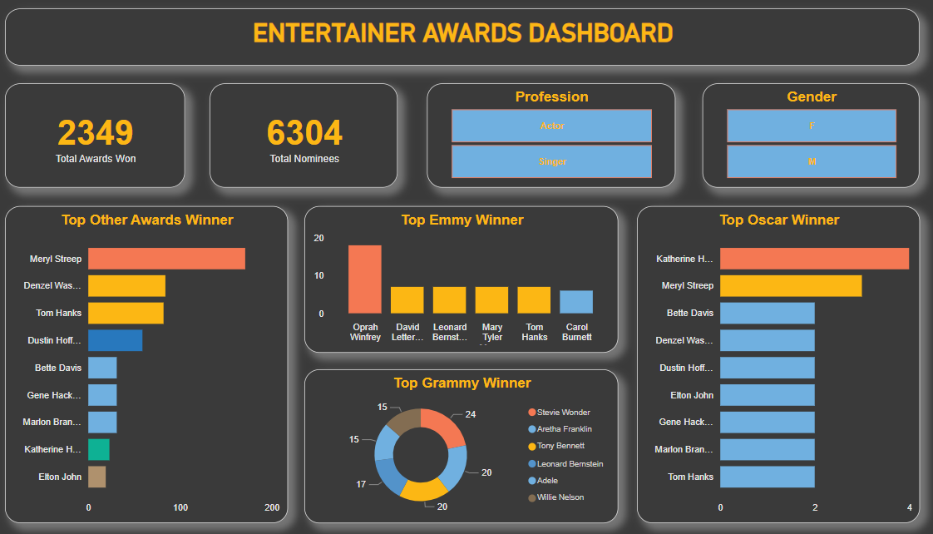
Dashboard
KIANA ANDERSON, OPERATIONS MANAGER
DATE

Slide 8
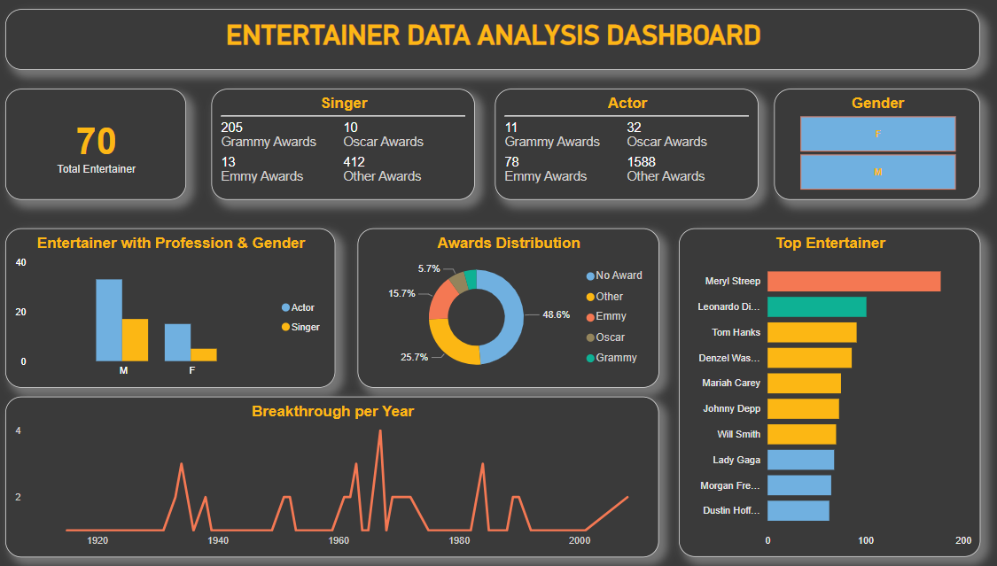
Dashboard
KIANA ANDERSON, OPERATIONS MANAGER
DATE

